Slide 1
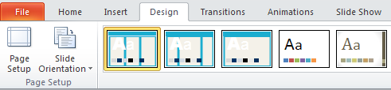
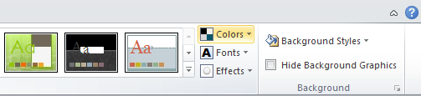
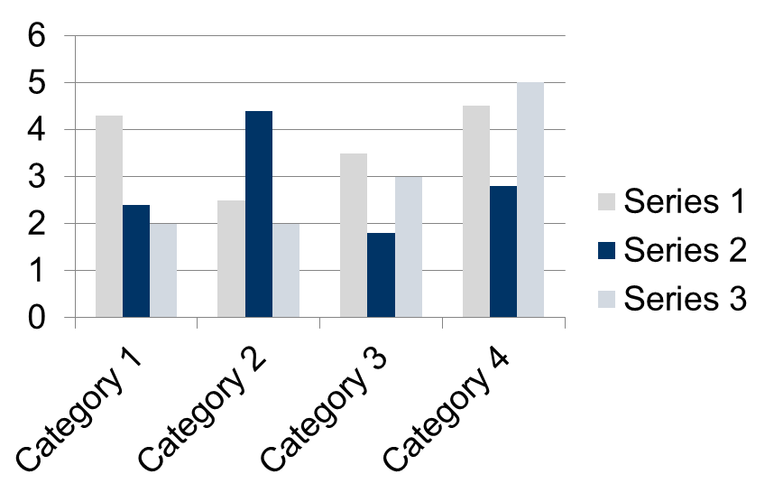
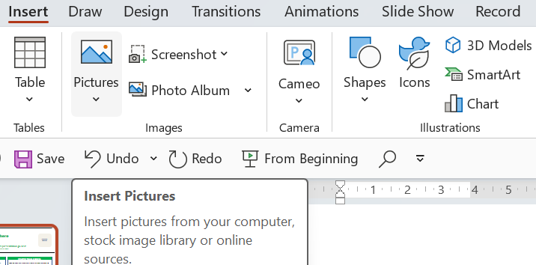
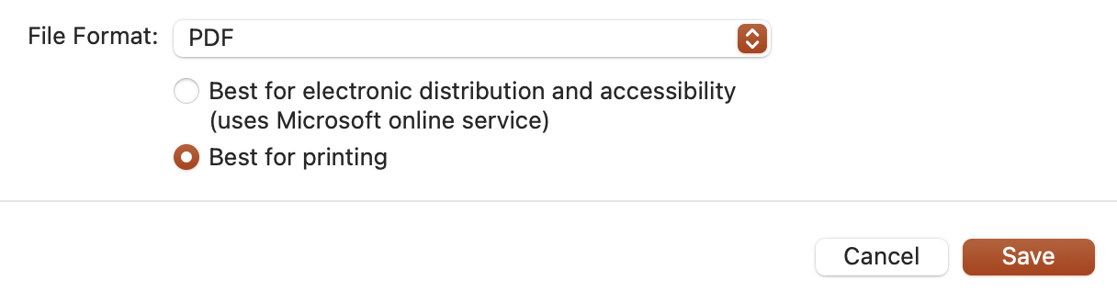
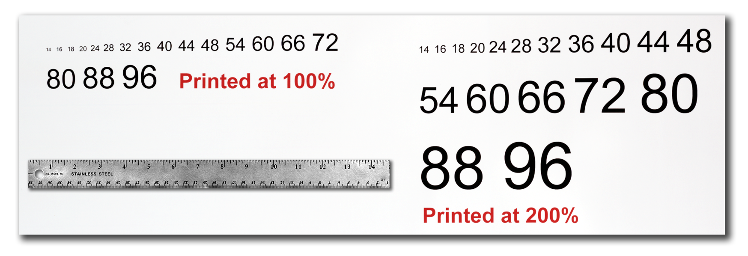
The poster title goes here
and here
The names of the people who have contributed to this presentation go here.
The names and addresses of the associated institutions go here.
INSERT YOUR
LOGO HERE
Introduction
Changing The Template Colour Schemes
Importing Tables & Graphs
This template was designed to produce a 1189mm x 841mm (A0 size) poster in portrait orientation. Please do not change the orientation – if you do, your poster will not fit on our poster boards.
Making use of this template will ensure that your poster will look professional, easy to read and save you valuable time in the layout of your presentation.
For poster design beginners we have included many useful tips that you can find on the poster template itself.
If you wish to further customize your poster presentation, this can be done by selecting a preset colour scheme from the colours option under the DESIGN tab. If you would like to change the default colors and use your own color scheme, go to the DESIGN tab (Figure 2). Then click on the COLORS drop-down menu on the right (Figure 3). There, you can try different colour schemes until you find the one you like.
Importing tables, charts and graphs is easier than importing photos. To import charts and graphs from Excel, Word or other applications, select EDIT>COPY, to copy your chart and then come back to PowerPoint. From PowerPoint, select EDIT>PASTE and paste the chart on the poster. You can scale your charts and tables proportionally by holding down the Shift key and dragging in or out one of the corners.
TABLE SAMPLE
1998 | 1999 | 2000
2001 | 2002 | 2003
2004 | 2005 | 2006
Figure 2
Figure 3
Poster Basics – Poster Layout
Exporting Your PowerPoint File to PDF
To start using this template you first need to delete most of the contents of this page. Keep the poster title and rename the various green section headers to match the headings in your poster (Introduction, Methods, Results, References, etc.). If you need more, then use the “copy” and “paste” commands to create as many copies of the green section headers as needed.
Move the headers roughly to where you think they need to be on the poster, so you can get a better idea of the overall poster layout. This will help you organize your content.
When adding text, it is easiest to use the existing text boxes in this template. You can type directly onto this template or copy the text from another source.
Repeat the process throughout the poster as needed.
Important: Please upload the final poster to the EasyChair platform in PDF format.
To ensure the highest possible print quality, please follow the steps below:
Open the PowerPoint file.
Go to File → Save As.
Choose the location where you want to save the file.
Select PDF as the file format.
Choose Best for printing.
Click Save.
This will export the presentation as a high-quality PDF suitable for professional printing.
Importing Photos
It is highly recommended to use the largest images you have access to for your poster. Avoid images downloaded from the web and avoid copying and pasting images instead of using the “Insert” command. To insert an image to your poster go to the INSERT tab and then click on PICTURE (Figure 4).
Figure 4
Figure 5
When the only source of a needed photo or graphic is the Web, scaling must be applied with caution.
A simple way to preview the printing quality of an image is to zoom in at 100% or 200%, depending on the final size of the poster. What you’ll see is likely what you’ll get at printing time.
Acknowledgements
Acknowledgements might go here.
Labeling Your Headers
Text Sizes
The blue header bars are used to identify and separate the main topics of your presentation. The most commonly used headers in poster presentations are:
For this poster template the Arial font family is used at several recommended text sizes. You can use any typeface you like and at any size but try to stay close to the suggested limits.
Figure 1 gives a visual reference of what different font sizes look like when printed at 100% and at 200%.
Due to a page size limitation in PowerPoint and unless your poster is going to be less than 56” in length, all the work done on this template is at half the size of the final poster. For example, if you choose a 21 point font for this poster, the actual printed size will appear as 42 points.
Introduction, Summary or Abstract | Conclusion
Materials and Methods | References
Results | Acknowledgements
Contact Information
Corresponding author’s Name
Address | Tel: +1 066 - 666666 Email: author@address.org Web: www.yourwebsite.org
Figure 1

